Slide 1

Data Types, operators, Boolean values
Course Name: Python Programming
Course Code: - E1UA311C
Instructor Name: Pooja Vajpayee
Duration: 50 Mins

Slide 2


Review of the key concepts of last session
--- Keywords, identifiers and variables

Slide 3
At the end of this session students will be able to
Learning Outcome 1 : Identify different Data types, Operators and Boolean values in python programming.
Learning Outcome 2: Demonstrate the use of operators and Boolean values in expressions.

Slide 4
Session Outline
1. Introduction to Python Language.
2 . Opening and Learning Outcomes.
3. Data Types, operators.
4. A1 ( MCQ):
5. Boolean values.
6 . A2 (MCQ):
7. Conclusion & Closure

Slide 5
Data Types in Python
int
float
str
boolean
list
tuple
Range
dict

Slide 6
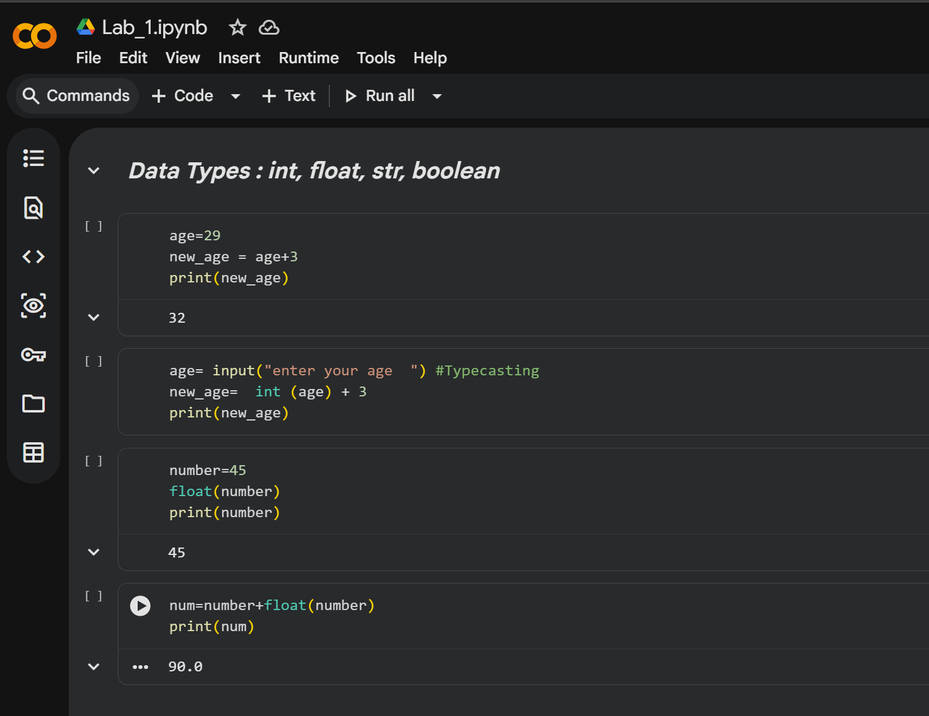

Slide 7

Operators in Python
Arithmetic (+, -, *, /, //, %, **))
Comparison (<, <=, >, >=, ==, !=)
Logical (and, or, not)
Assignment (=, +=, -=, *=)
Bitwise (&, |, <<, >> , ~)

Slide 8
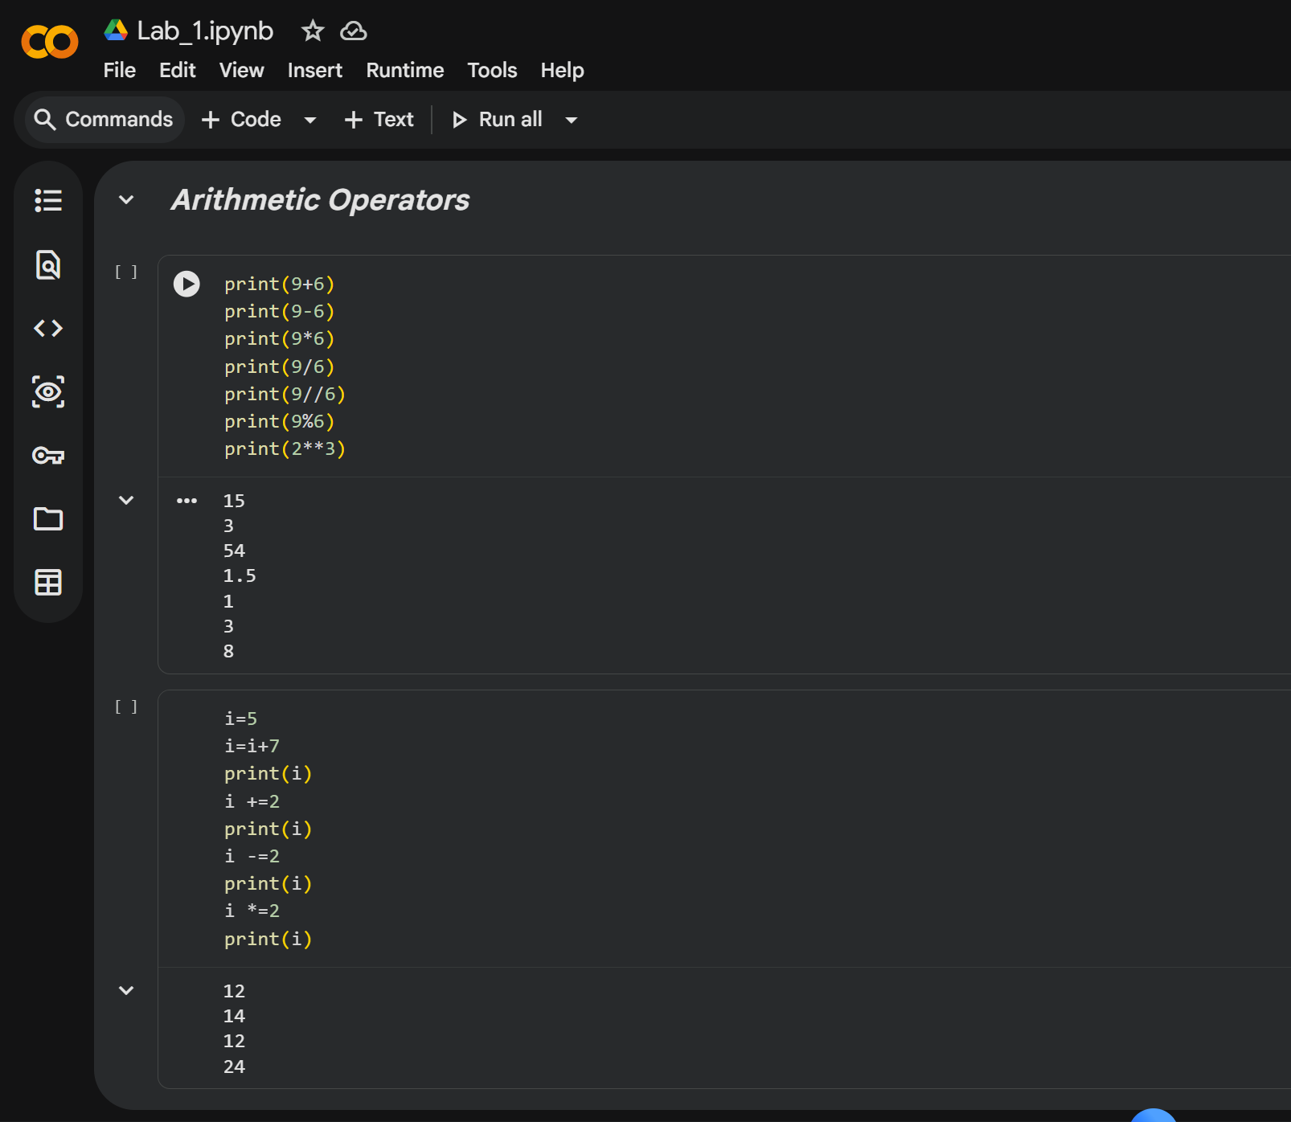

Slide 9
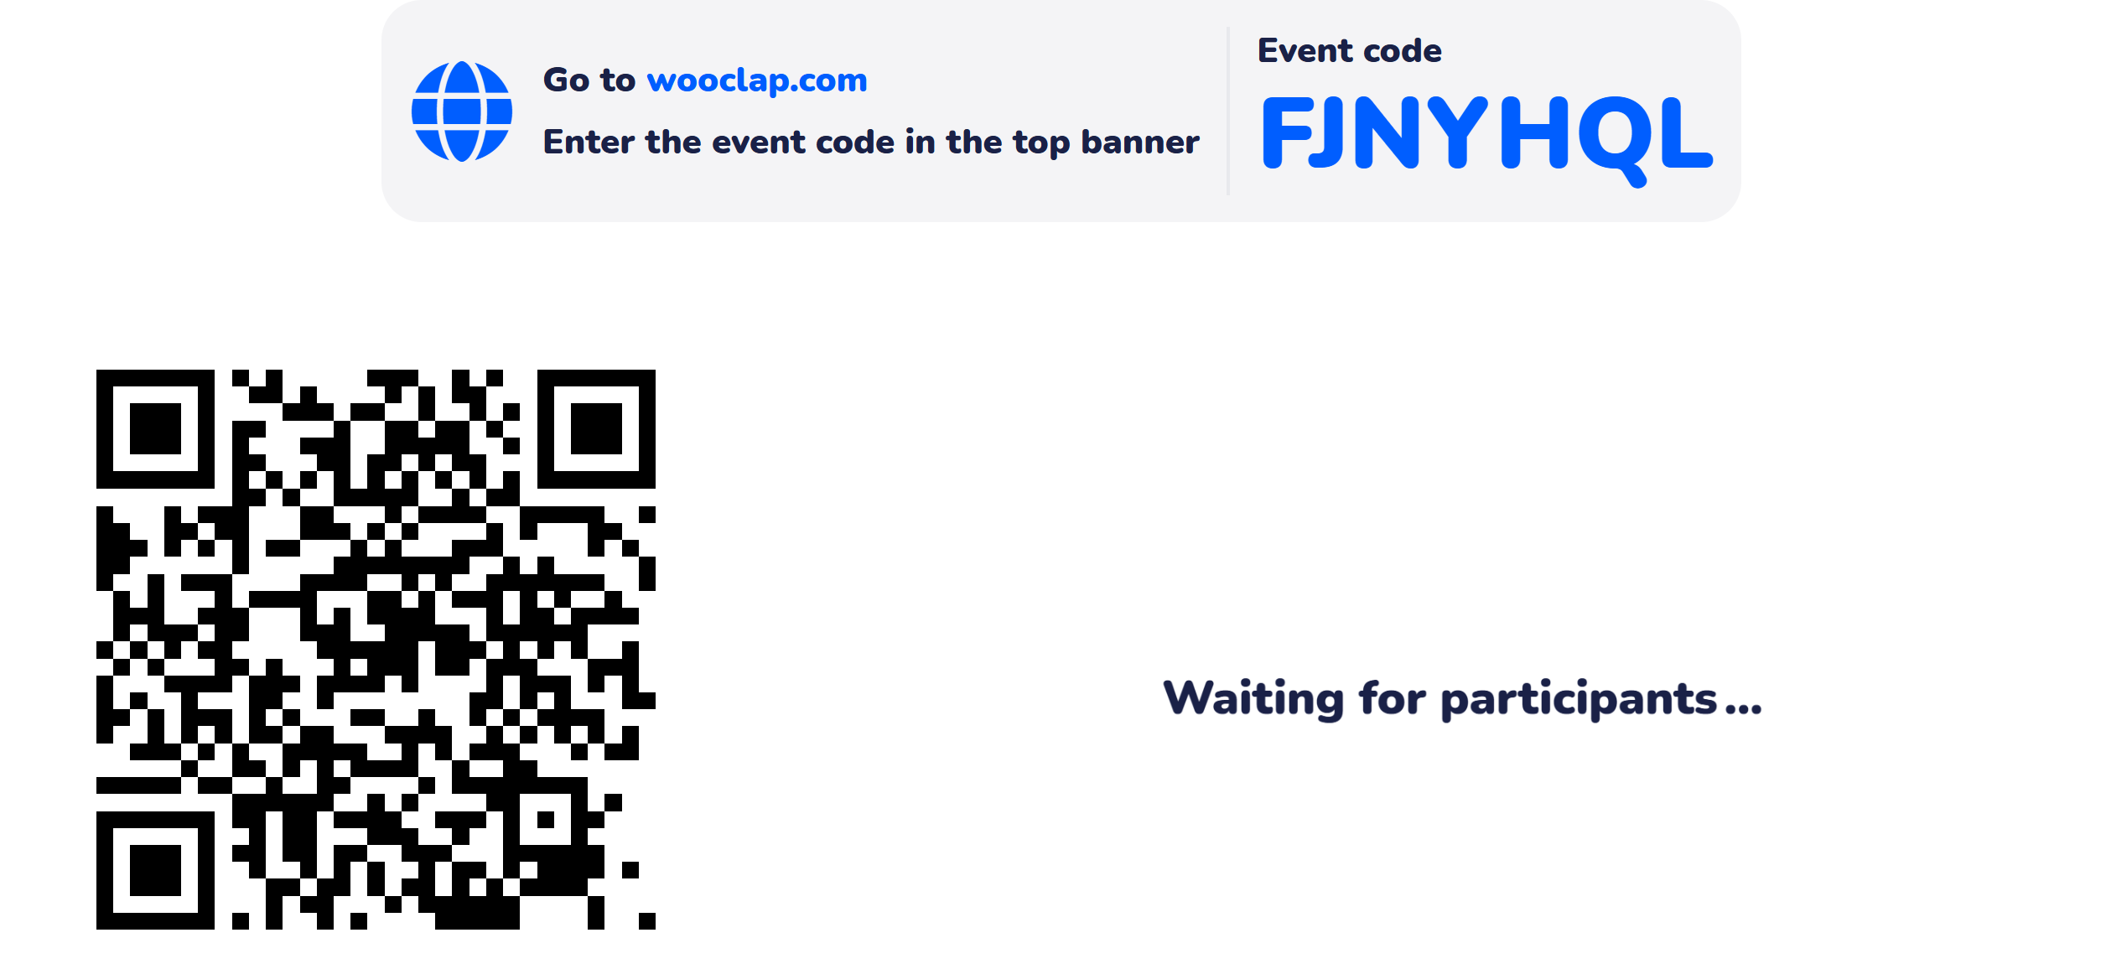
Learning Activity 1

Slide 10
The Boolean data type in Python represents two values:
True
False

Slide 11
Example 1:
x = True
y = False
print(x) # Output: True
print(y) # Output: False
Example 2:
a = 5
b = 10
print(a > b) # Output: False
print(a < b) # Output: True

Slide 12
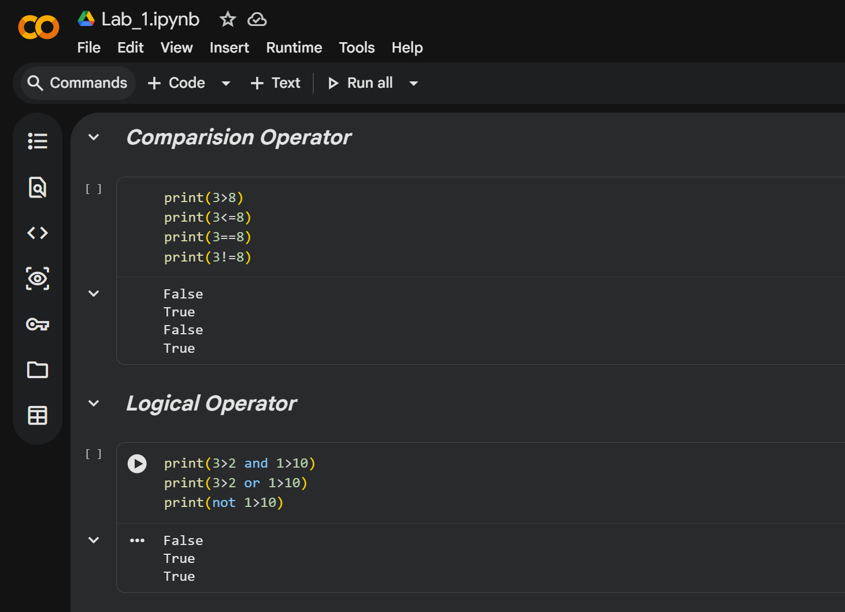

Slide 13
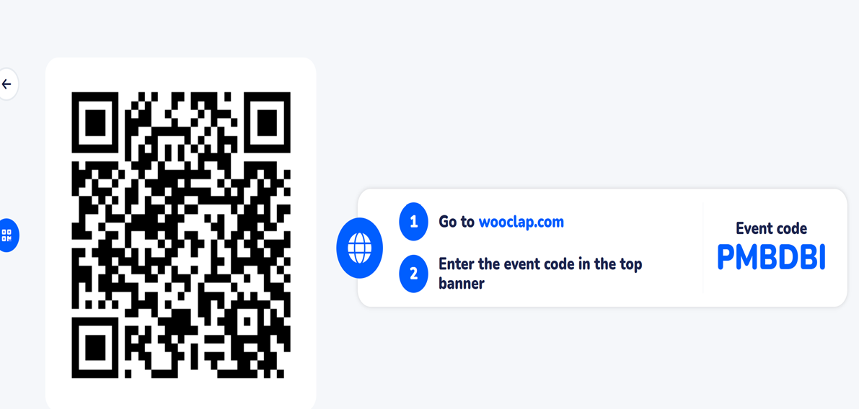
Learning Activity 2

Slide 14
Conclusions-
✅ Python is beginner-friendly and widely used.
✅Understanding syntax, keywords, and data types is essential.
✅ Operators help in performing various computations.
✅ Start coding and explore Python further!

Slide 15
Now Students are able to :
Learning Outcome 1 : Identify different Data types, Operators and Boolean values in python programming.
Learning Outcome 2: Demonstrate the use of operators and Boolean values in expressions.

Slide 16
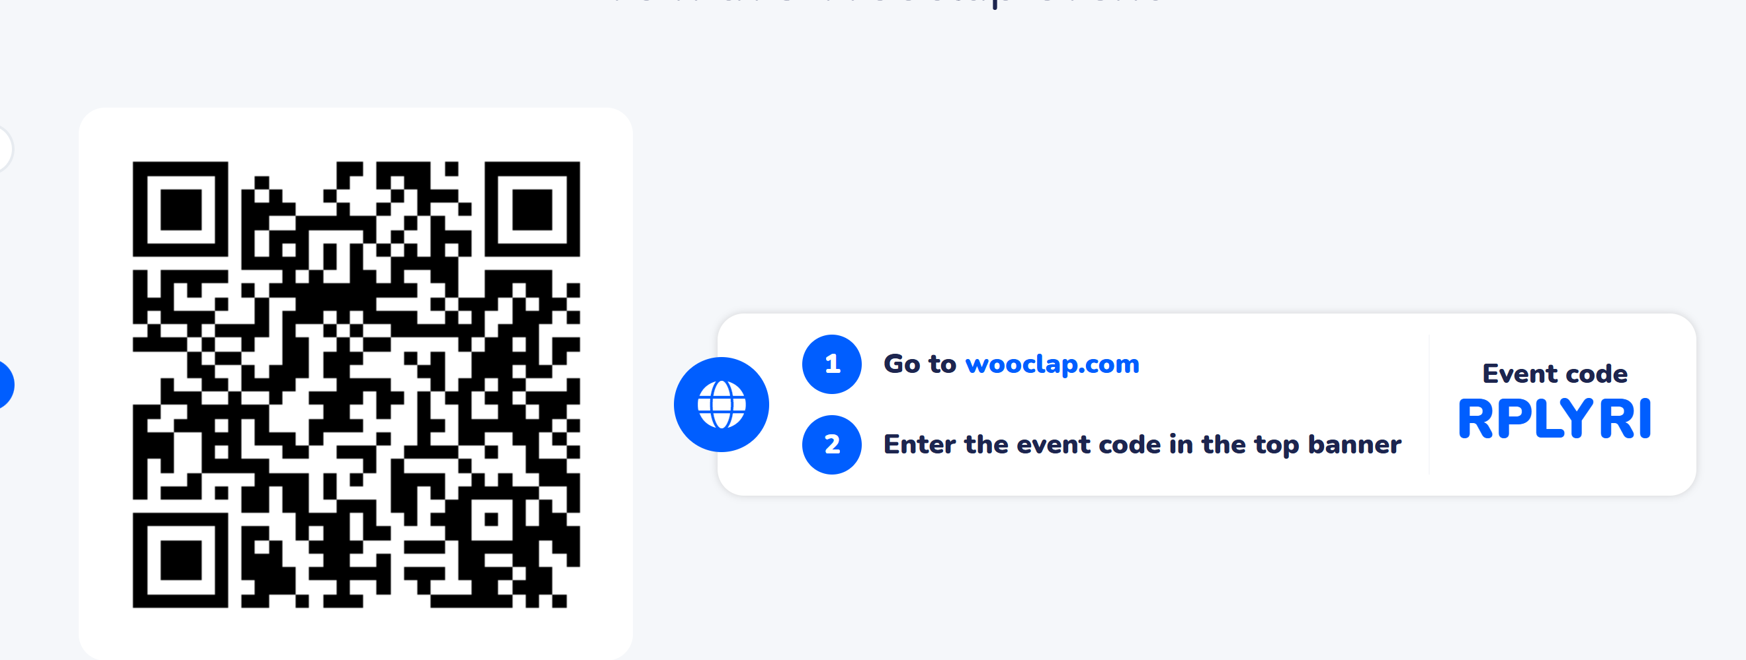
post session activities
* Attempt the Post-session activity on LMS, before next session.

Slide 17
Next session:
Conditional Execution, Loops.

Slide 18

Thank You

